Slide 1
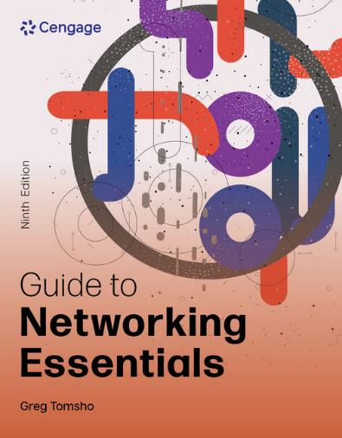
Guide to Networking Essentials, 9e
Chapter 7: Network Reference Models and Standards
.

Slide 2
Chapter Objectives
By the end of this chapter, you should be able to:
Describe the OSI Model and IEEE 802 Networking Standards
Summarize the IEEE 802 Networking Standards

Slide 3
Introducing the OSI Model and the IEEE 802 Networking Standard
The Open Systems Interconnection (OSI) reference model proposed by the International Organization for Standardization (ISO) provides a common framework for developers and students of networking to work with and learn from
The OSI model is not specific to any protocol suite and can be applied to most networking protocols
This model is a seven-layer organization of how data travels from place to place on any given network

Slide 4
Role of a Reference Model (1 of 3)
To see the value of a layered model, look at an example of a letter being created, sent and delivered by the US Postal Service:
The letter has to be written
The letter has to be placed in an envelope and addressed in the correct format
The envelope has to be stamped
The local post office in the destination town has to sort the letter correctly based one the zip code and get it on the right plane to the destination

Slide 5
Role of a Reference Model (2 of 3)
To see the value of a layered model, look at an example of a letter being created, sent and delivered by the US Postal Service (continued):
The post office in the destination town has to sort the letter correctly for the right part of town
The local carrier has to deliver the letter to the correct house
The recipient has to receive the letter, open it, and read it
A layered approach to a complicated process reduces its complexity and turns it into a series of interconnected tasks

Slide 6
Role of a Reference Model (3 of 3)
Each task of the previous example can be handled separately without affecting the procedures of the other tasks.
For example, in the step where the local carrier delivers the letter to the correct house:
Let’s say he currently walks on his route, which takes a considerable amount of time
He gets an “upgrade” to a delivery truck so that he can perform his task faster
As you can see, one part of the process can change but the rest of the process remains unchanged

Slide 7
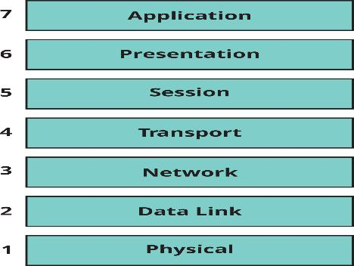
Structure of the OSI Model (1 of 6)
Figure 7-1 The seven layers of the OSI reference model

Slide 8
Structure of the OSI Model (2 of 6)
Each layer in the OSI model has its own set of well-defined functions
The functions of each layer communicate and interact with the layers immediately above and below it
Example: The Transport layer works with the Network layer below it and the Session layer above it
The next slide will compare the TCP/IP model with the OSI model
Each layer on one computer behaves as though it were communicating with the same layer on the other computer
This behavior is known as peer communication between layers

Slide 9
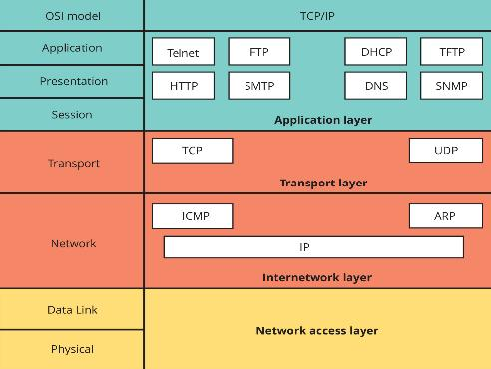
Structure of the OSI Model (3 of 6)
Figure 7-2 Comparing the OSI model and the TCP/IP model

Slide 10
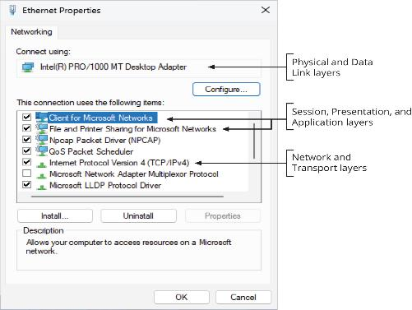
Structure of the OSI Model (4 of 6)
Figure 7-3 Layers of the OSI model in the Ethernet Properties dialog box

Slide 11
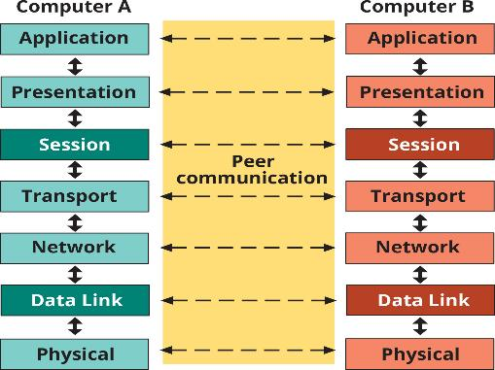
Structure of the OSI Model (5 of 6)
Figure 7-4 Peer communication between OSI layers

Slide 12
Structure of the OSI Model (6 of 6)
On data’s way down the protocol stack:
It’s divided into data units suitable for each layer
Each unit, called protocol data units (PDU), is passed from one layer to another on its way up or down the protocol stack
Some layers add their own formatting to the PDU, which is called a header
When data arrives at the receiving end, it is passed up the protocol stack:
At each layer, software reads its PDU data and strips its header information (called de-encapsulation) and passes the PDU to the next higher layer

Slide 13
Application Layer
The Application layer (Layer 7) provides interfaces for applications to access network services
Examples are file sharing, message handling, and database access
Generally, components at the Application layer have both a client component and a server component
Common protocols found at Layer 7 include HTTP, FTP, SMB/CIFS, TFTP, and SMTP
Possible problems at this layer include missing or misconfigured client or server software and incompatible or obsolete commands used to communicate between a client and server

Slide 14
Presentation Layer
The Presentation layer (Layer 6) handles data formatting/translation
For outgoing messages:
It converts data into a format specified by the Application layer
For incoming messages:
It reverses the conversion if required by the receiving application
A software component known as a “redirector” operates at this layer
It intercepts requests for service from the computer, requests that can’t be handled locally are redirected across the network to a network resource that can handle the request

Slide 15
Session Layer
The Session layer (Layer 5) permits two computers to hold ongoing communications, called a “session”, so applications on either end of the session can exchange data for as long as the session lasts
Common network functions at this layer:
Name lookup and user logon and logoff
This layer also manages the mechanics of ongoing conversations
Checkpointing is performed at this layer, which is a synchronization process between two related streams of data
Example: keeping the audio in sync with video

Slide 16
Transport Layer (1 of 4)
The Transport layer (Layer 4) manages data transfer from one Application-layer protocol to another across a network
It breaks long data streams down into smaller chunks called “segments”
Segmenting data is important because every network technology has a maximum frame size called the maximum transmission unit (MTU)
The Transport layer includes flow control and acknowledgements to ensure reliability, and it handles resequencing segments into the original data on receipt
The PDU at this layer is a segment (UDP’s PDU is often called a datagram)

Slide 17
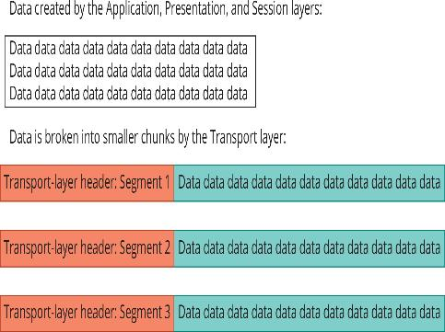
Transport Layer (2 of 4)
Figure 7-5 The Transport layer breaks data into segments

Slide 18
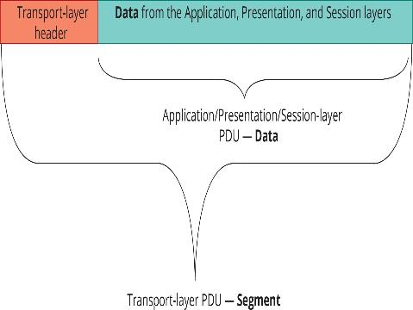
Transport Layer (3 of 4)
Figure 7-6 The Transport-layer PDU: a segment

Slide 19
Transport Layer (4 of 4)
Some key fields in the Transport-layer header include:
Source and destination port numbers
Sequence and acknowledgement numbers
Window size
Problems that can occur at this layer include segments that are too large for the medium between source and destination networks
This forces the Network layer to fragment the segments, which causes performance degradation
Hackers can exploit TCP’s handshaking feature with a half-open SYN attack

Slide 20
Network Layer (1 of 3)
Part 2
The Network layer (Layer 3) handles logical addressing, translates logical network addresses (IP addresses) into physical addresses (MAC addresses), and performs best path selection and routing in an internetwork
Access control is handled at this layer during the routing process
The router consults a list of rules before forwarding an incoming packet to determine whether a packet meeting certain criteria should be permitted through
The PDU at the Network layer is a packet

Slide 21
Network Layer (2 of 3)
Software components working at this layer include IP, ARP and ICMP
Routers operate at this layer
A switch with routing capabilities (called a “Layer 3 switch”), also works at the Network layer
Problems that can occur at the Network layer often include:
Incorrect IP addresses or subnet masks, incorrect router configuration, and router operation errors

Slide 22
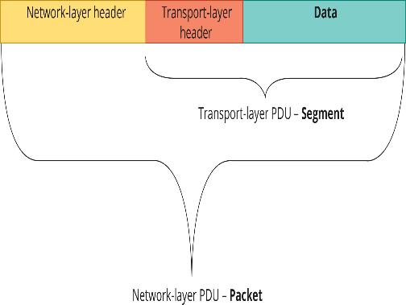
Network Layer (3 of 3)
Figure 7-7 The Network-layer PDU: a packet

Slide 23
Data Link Layer (1 of 4)
The Data Link layer (Layer 2) works with frames and is the intermediary between the Network layer and Physical layer
It defines how computers access the network medium (also called media access control)
The MAC address is defined at this layer
A layer 2 frame consists of both a header and a trailer component:
The trailer component is labeled “FCS” (frame check sequence) and contains the CRC error-checking code

Slide 24
Data Link Layer (2 of 4)
The CRC value is recalculated on the receiving end
If the sent and recalculated values agree, the assumption is that the data wasn’t altered during transmission
The Data Link layer discards frames containing CRC and frame errors
The Data Link header contains fields for source/destination addresses
After receiving a frame from the Physical layer and verifying the destination MAC address and the CRC, the Data Link layer strips its header and trailer information from the frame
It then sends the resulting packet up to the Network Layer for further processing

Slide 25
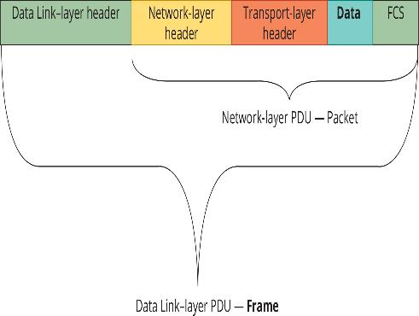
Data Link Layer (3 of 4)
Figure 7-8 The Data Link-layer PDU: a frame

Slide 26
Data Link Layer (4 of 4)
The software component operating at this layer is in the NIC driver
Hardware components that operate at this layer include NICs and switches
Problems at this layer include collisions and invalid frames, which can be caused by collisions, poor network design, line noise, or NIC driver problems
Another problem at this layer results from trying to use incompatible network technologies

Slide 27
Physical Layer (1 of 2)
The Physical layer (Layer 1) converts bits into signals for outgoing messages and signals into bits for incoming messages
The type of signals generated depend on the medium:
Wire media uses electrical pulses, fiber-optic uses light pulses and wireless media uses radio waves
Details for creating a physical network connection are specified at this layer
Example: the type of connectors used to attach the medium to the NIC

Slide 28
Physical Layer (2 of 2)
Encoding is representing 0s and 1s by a physical signal such as electrical voltage or a light pulse
Encoding happens at the Physical layer
Components at this layer include all the cable and connectors used on the medium, along with repeaters and hubs
Problems occurring here are often related to:
Incorrect media termination
EMI or noise that scrambles the signals
NICs and hubs that are misconfigured or malfunctioning

Slide 29
Knowledge Check Activity 7-1
At what layer of the OSI model would you find the function of bit encoding?
a. Layer 1
b. Layer 2
c. Layer 3
d. Layer 4

Slide 30
Knowledge Check Activity 7-1: Answer
At what layer of the OSI model would you find the function of bit encoding?
Answer: a. Layer 1
Explanation: The Physical layer specifies how to encode 1s and 0s, bit signals. Encoding is representing 0s and 1s by a physical signal, such as electrical voltage or a light pulse.

Slide 31
IEEE 802 Networking Standards (1 of 2)
The Institute of Electrical and Electronics Engineers (IEEE) defined LAN standards to ensure that network interfaces and cabling from multiple manufacturers would be compatible
This effort was called Project 802 to indicate the year (1980) and the month (Feb) of its inception
IEEE 802 predates the OSI Model
Most of the standards affect the elements from the lower two levels of the OSI Model

Slide 32
IEEE 802 Networking Standards (2 of 2)
The 802 specifications describes how NICs can access and transfer data across a variety of networking media and what’s involved in attaching, managing, and detaching these devices in a network

Slide 33
IEEE 802 Specifications (1 of 2)
The IEEE numbers the collections of 802 documents starting with 802.1, 802.2, etc…
When a technology is enhanced each enhancement is specified by letters after the number
For example: 802.3 is the original Ethernet and 802.3u specifies 100BaseT Ethernet

Slide 34
IEEE 802 Specifications (2 of 2)
Table 7-2 IEEE 802 standards (most pertinent to this book)
Standard | Name | Explanation
802.3 | Ethernet LAN | Covers all forms of Ethernet media and interfaces, from 10 Mbps to 10 Gbps (10 Gigabit Ethernet)
802.11 | Wireless Networks | Sets standards for wireless networking for many different broadcast frequencies and techniques
802.15 | Wireless PAN | Covers standards for wireless personal area networks
802.16 | Wireless MAN (WiMAX) | Covers wireless metropolitan area networks

Slide 35
IEEE 802 Extensions to the OSI Reference Model (1 of 3)
The two lowest layers of the OSI model define how computers attach to specific network media
These layers also specify how more than one computer can access the network without causing interference with other computers on the network
The IEEE 802 specification expanded the OSI model by separating the Data Link layer into these sublayers:
Logical Link Control (LLC) for error recovery and flow control
Media Access Control (MAC) for controlling access to network media

Slide 36
IEEE 802 Extensions to the OSI Reference Model (2 of 3)
The Logical Link Control (LLC) sublayer controls data-link communication and defines the use of logical interface points used to communicate to the upper OSI layers
It is the sublayer that communicates with the Network layer
The Media Access Control (MAC) sublayer manages access to the physical medium and communicates with the Physical layer

Slide 37
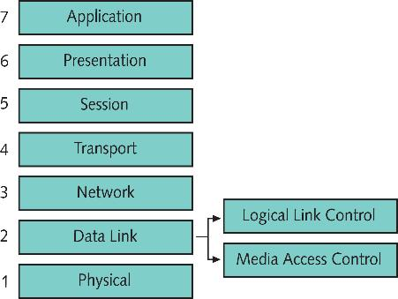
IEEE 802 Extensions to the OSI Reference Model (3 of 3)
Figure 7-9 The IEEE 802 standard divides the OSI Data Link layer into two sublayers

Slide 38
Knowledge Check Activity 7-2
Which of the following is a function of the LLC sublayer?
a. Manages access to the physical medium
b. Deals with physical addresses
c. Communicates with the Network layer
d. Communicates with the NIC

Slide 39
Knowledge Check Activity 7-2: Answer
Which of the following is a function of the LLC sublayer?
Answer: c. Communicates with the Network layer
Explanation: The Logical Link Control (LLC) sublayer (defined by 802.2) controls data-link communication and defines the use of logical interface points, called “service access points (SAPs),” that other computers can use to transfer information from this sublayer to the upper OSI layers. It’s also responsible for error recovery in some situations and is the sublayer that communicates with the Network layer.

Slide 40
Self Assessment
Using Figure 7-2, compare the TCI/IP model versus the OSI model.
Which layers of the OSI model does the LLC sublayer and MAC sublayer communicate with? Why do you think it is necessary for the Data Link layer to be divided into sublayers?

Slide 41
Summary
Now that the lesson has ended, you should be able to:
Describe the OSI Model and IEEE 802 Networking Standards
Summarize the IEEE 802 Networking Standards

